Slide 1
Introduction
CSIT882: Data Management Systems
Notes:
<!-- Neural, Brian, Male, British English. -->
<speak>
<break time="0.5s"/>
<prosody rate="90%">
Introduction.
This presentation introduces the basic concepts used in data management, and it also overviews electronic and persistent storage devices.
</prosody>
</speak>
Systems Analysis

Slide 2
Outline
Data ? What is it ?
Electronic Storage Devices
Persistent Storage Devices
Notes:
Brian, Male, British English.
<speak>
<break time="0.5s"/>
<prosody rate="90%">
Data ? What is it ?
<break time="0.5s"/>
</prosody>
</speak>
Systems Analysis

Slide 3

Data ? What is it ?
Data is a set of values of qualitative or quantitative variables[ˈvɛriəbəlz]; restated, pieces of data are individual pieces of information, https://en.wikipedia.org/wiki/Data
Data can be measured, collected and reported, and analysed[ˈænəlaɪzd], whereupon it can be visualised using graphs or images
Data as a general concept refers to the fact that some existing information or knowledge is represented or coded in some form suitable for better usage or processing
A bit is the smallest unit of data
A bit is the basic unit of information in computing and digital communications, https://en.wikipedia.org/wiki/Bit
A bit can have only one of two values, and may therefore be physically implemented with a two-state device
These values are most commonly represented as either a 0 or 1
A byte is a sequence of 8 bits
Notes:
<!-- Brian, Male, British English. -->
<speak>
<break time="0.5s"/>
<prosody rate="90%">
We start with a few simple definitions of the basic concepts.
Accordingly to Wikipedia, data is a set of values of qualitative or quantitative variables; restated, pieces of data are individual pieces of information
<break time="0.8s"/>
Data can be measured, collected and reported, and analysed, whereupon it can be visualised using graphs or images
<break time="0.8s"/>
Data as a general concept refers to the fact that some existing information or knowledge is represented or coded in some form suitable for better use or processing
<break time="0.8s"/>
A bit is the smallest unit of data
<break time="0.8s"/>
Accordingly to Wikipedia, a bit is the basic unit of information in computing and digital communications,
<break time="0.8s"/>
A bit can have only one of two values, and may therefore be physically implemented with a two-state device
<break time="0.8s"/>
These values are most commonly represented as either a 0 or 1
<break time="0.8s"/>
A byte is a sequence of 8 bits
</prosody>
</speak>
Systems Analysis

Slide 4
Outline
Data ? What is it ?
Electronic Storage Devices
Persistent Storage Devices
Notes:
Brian, Male, British English.
<speak>
<break time="0.5s"/>
<prosody rate="90%">
Electronic Storage Devices
</prosody>
</speak>
Systems Analysis

Slide 5
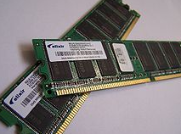
Electronic storage devices
Electronic storage devices provide read/write access to the sequences of bytes [baɪts]
Transient [ˈtrænʃnt] (volatile [ˈvɑːlətl] ) storage devices are computer memory that requires power to maintain the stored information; It retains its contents while powered on but when the power is interrupted the stored data is lost very rapidly or immediately
Random-access memory (RAM) device allows data items to be accessed (read or written) in almost the same amount of time, irrespective of the physical location of data inside the memory
Notes:
<!-- Brian, Male, British English. -->
<speak>
<break time="0.5s"/>
<prosody rate="90%">
Electronic storage devices provide read and or write access to the sequences of bytes.
<break time="0.8s"/>
Transient, also called a volatile storage devices are computer memory that requires power to maintain the stored information; it retains its contents while powered on but when the power is interrupted the stored data is lost very rapidly or immediately.
<break time="0.8s"/>
Random-access memory, also called as ram, device, visible on a picture below, allows data items to be accessed (read or written) in almost the same amount of time irrespective of the physical location of data inside the memory.
<break time="0.8s"/>
</prosody>
</speak>
Systems Analysis

Slide 6
Electronic storage devices
Persistent storage (nonvolatile[nɑnˈvɑlətəl] ) devices are any method or apparatus [ˌæpəˈrætəs] used for efficiently storing data structures such that it can be accessed using memory instructions or memory APIs even after the end of the process that created or last modified them
Persistent storage (nonvolatile) devices include:
- Solid State Drives (SSD)
- Hard Disk Drives (HDD)
- Optical Disk Drives (ODD)
Non-Volatile Memory (NVM)
Notes:
<-- Brian, Male, British English. -->
<speak>
<break time="0.5s"/>
<prosody rate="90%">
Persistent storage, also called a nonvolatile device, is any method or apparatus used for efficiently storing data structures such that, it can be accessed using memory instructions or memory application programming interfaces even after the end of the process that created or last modified them.
<break time="0.8s"/>
Persistent storage devices include:
<break time="0.3s"/>
Solid State Drives (SSD)
<break time="0.3s"/>
Hard Disk Drives (HDD)
<break time="0.3s"/>
Optical Disk Drives (ODD) and
recently developed non-volatile memory (NVM)
<break time="0.8s"/>
In the future we shall concentrate on the different types of persistent storage devices.
</prosody>
</speak>
Systems Analysis

Slide 7
Outline
Data ? What is it ?
Electronic Storage Devices
Persistent Storage Devices
Notes:
Brian, Male, British English.
<speak>
<break time="0.5s"/>
<prosody rate="90%">
Persistent Storage Devices
</prosody>
</speak>
Systems Analysis

Slide 8
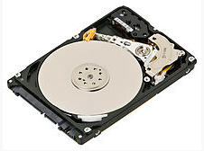
Persistent Storage Devices
Hard Disk Drive (HDD), hard disk, hard drives are an electro-mechanical persistent storage devices used for storing and retrieving digital information
Hard disk drives consist of one or more rapidly rotating disks covered with magnetic material and one or more disk heads located on the movable arms
A moveable arm with the disk heads is visible below just above disk platters
Notes:
<!-- Brian, Male, British English -->
<speak>
<break time="0.5s"/>
<prosody rate="90%">
A hard disk drive, commonly abbreviated as HDD and also known as a hard disk or a hard drive is an electro-mechanical persistent storage device used for storing and retrieving digital information.
<break time="0.3s"/>
A hard disk drive consists of one or more rapidly rotating disks covered with magnetic material and one or more disk heads located on the movable arms.
<break time="0.3s"/>
An opened box of a hard drive is displayed below. The disk heads used to read read data are visible just above disk platters.
</prosody>
</speak>
Systems Analysis

Slide 9
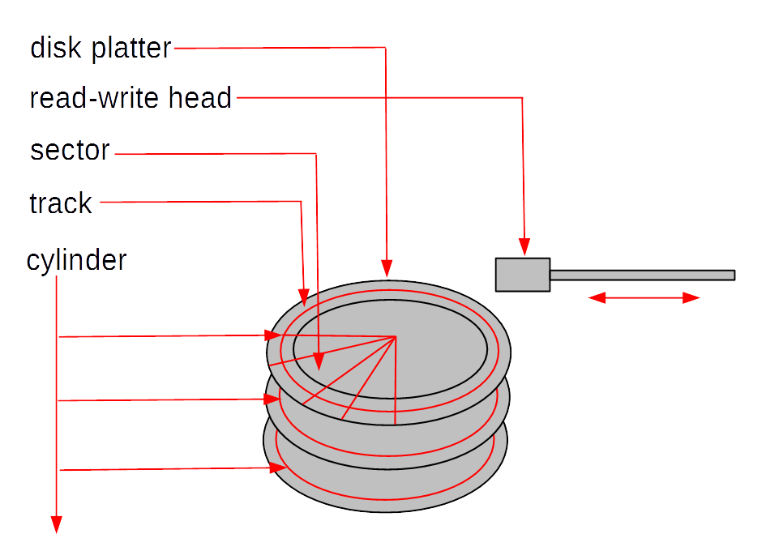
Persistent Storage Devices
A simple model of HDD consists of a number of disk platters and read/write disk heads that can change positions over the platters
A disk platter consists of a number of tracks and each track consists of a sequence of sectors
All tracks located on different platters and equally distant from a center of platters are called as a cylinder
A concept of cylinders can be considered as a logical model of data at the lowest level of abstraction
Notes:
<!-- Brian, Male, British English -->
<speak>
<break time="0.5s"/>
<prosody rate="95%">
A simple model of hard disk drive consists of a number of vertically stacked disk platters and read write disk heads that can change positions over the platters. Please see a picture below.
<break time="0.5s"/>
A disk platter consists of a number of tracks and each track consists of a sequence of sectors.
<break time="0.5s"/>
All tracks are located on different platters and equally distant from a center of platters form a cylinder.
<break time="0.5s"/>
The disk platters rotate and the disk heads move forward and backward to read and write sequences of sectors from the tracks.
<break time="0.5s"/>
All tracks located on the same cylinder can be accessed in the same moment in time.
<break time="0.5s"/>
A concept of cylinder can be considered as a logical model of data at the lowest level of abstraction.
</prosody>
</speak>
Systems Analysis

Slide 10
Persistent Storage Devices
Physical parameters of HDD:
- Seek time: time needed to move the disk arm to a given cylinder position (from ~15 to ~2 msec)
- Rotational latency: time needed to rotate a platter to a given position (~ 4 msec)
- Transfer time: time needed to read/write data from or to a platter (~13 Mbytes per sec)
- Average disk access time: an average time that is needed to transfer a block of data (~10msec = 0.001 sec)
- In comparison, the main memory access time, time needed to read 1 byte from RAM (~10nanosec = 0.000000001 sec) [ˈnænoʊsekənd]
- Operations: read the sector, write the sector and move disk head
Notes:
<!-- Brian, Male, British English -->
<speak>
<break time="0.5s"/>
<prosody rate="95%">
The physical parameters of a hard disk drive are the following.
<break time="0.3s"/>
Seek time is a period of time needed to move disk arm to a given cylinder position, it takes approximately from 15 to 2 miliseconds.
<break time="0.3s"/>
Rotational latency is a period of time needed to rotate a platter to a given position, it takes approximately 4 miliseconds.
<break time="0.3s"/>
Transfer time is the period of time needed to read write data from to a platter, approximately 13 megabytes can be read or written per second.
<break time="0.3s"/>
Average disk access time is an average period of time needed to transfer a block of data, it takes approximately 10 miliseconds.
<break time="0.3s"/>
In comparison, the main memory access time, time needed to read 1 byte from ram takes approximately 10 nanoseconds, it is approximately a million times faster.
<break time="0.3s"/>
The elementary operations performed by a hard disk drive include: read sector, write sector, and move disk head operations.
</prosody>
</speak>
Systems Analysis

Slide 11
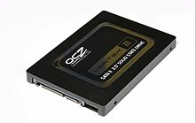
Persistent Storage Devices
Solid State Drive (SSD) uses nonvolatile memory, i.e., NAND flash is used as its storage media
SSD has no moving parts and it only uses silicon [ˈsɪlɪkən] as its media (it is "solid-state")
SSDs are common today in mobile devices such as smartphones and digital cameras; SD (Secure Digital) and CF (CompactFlash) memory cards are smaller and less complex versions of an SSD
Both HDD and SSD are part of a class of storage called block devices
Block devices use logical addressing to access data and abstract the physical media, using small, fixed, contiguous [kənˈtɪɡjuəs] segments of bytes as the addressable unit
Notes:
<!-- Brian, Male, British English -->
<speak>
<break time="0.5s"/>
<prosody rate="95%">
Solid State Drive, SSD, uses nonvolatile memory like nand flash as its storage media.
<break time="0.3s"/>
Solid state drive has no moving parts and it only uses silicon as its media, this is why it is called "solid-state".
<break time="0.3s"/>
Solid state drives are common today in mobile devices such as smartphones and digital cameras. For example SD and CF memory cards are smaller and less complex versions of a solid state drive.
<break time="0.3s"/>
Both hard disk drives and solid state drives belong to a class of storage devices called block devices.
<break time="0.3s"/>
Block devices use logical addressing to access data and abstract the physical media, using small, fixed, contiguous segments of bytes as an addressable unit.
Such segment of bytes is commonly called a data block.
</prosody>
</speak>
Systems Analysis

Slide 12
Persistent Storage Devices
Physical parameters of SSD:
- Random access time: time needed to retrieve data from various locations in the memory (under 0.1 msec)
- Transfer speed: reading up to 400 Mb/sec, writing at only 10-20 Mb/sec because all bits must be set to 0 before setting to 1, transfer is slower when a lot of individual blocks are accessed
- Capacity: 16Gb per chip, SSD consists of 8 to 226 chips
- For a comparison the main memory access time, time needed to read 1 byte from RAM (~10nanosec = 0.000000001 sec)
- Operations: read a sequence of bytes and write a sequence of bytes
Notes:
<!-- Brian, Male, British English -->
<speak>
<break time="0.5s"/>
<prosody rate="95%">
The physical parameters of solid state drive are the following.
<break time="0.3s"/>
Random access time is a period of time needed to retrieve data from various locations in memory, it is approximately under 0.1 milisecond.
<break time="0.3s"/>
Transfer speed is approximately 400 megabyte per second, when reading, and from 10 to 20 megabytes when writing. Writing is slower because all bits must be set to zero before setting to one. Transfer is also slower when a lot of small individual data blocks are accessed instead of a single large data block.
<break time="0.3s"/>
Capacity is 16 gigabytes per chip, a solid state drive consists of from 8 to 226 chips.
<break time="0.3s"/>
For a comparison, the main memory access time, time needed to read 1 byte from ram is approximately 10 nanoseconds.
<break time="0.3s"/>
The elementary operations performed by solid state drive include: read a sequence of bytes and write a sequence of bytes.
</prosody>
</speak>
Systems Analysis

Slide 13
Persistent Storage Devices
Non-Volatile Memory (NVM) is the name for a group of new technologies such as Phase-Change RAM, Magnetic RAM and Resistive RAM that enable non-volatile (persistent), memory chips that require low energy, and have density and latency closer to current DRAM chips
NVM has 4 times faster input/output operations per second than SSD and seek time for data and is ten times faster than SSD
NVM supports byte-addressable accesses and stores with a lower latency than SSD
Important properties of NVM include
- byte-addressability: supports byte-addressable loads and stores, no need to transfer data in blocks
high write throughput: NVM delivers more than an order of magnitude[ˈmæɡnɪtuːd] higher write throughput compared to SSD
read-write asymmetry [ˌeɪˈsɪmətri] : in certain NVM technologies, write take longer to complete when compared to read and excessive writes to a single memory cell can destroy it
Notes:
<!-- Brian, Male, British English -->
<speak>
<break time="0.5s"/>
<prosody rate="95%">
Non-Volatile Memory (NVM) is a name for a group of new technologies such as Phase-Change ram, Magnetic ram and Resistive ram that enable memory chips that are non-volatile (persistent), require low energy, and have density and latency closer to current Dram chips
A commercial implementation of non-volatile memory is the Intel Optane Persistent Memory Module, simply called as Optane Memory, available from 2019.
<break time="0.3s"/>
Non-volatile memory has 4 times faster input output operations per second than solid state drive and the seek time for data is ten times faster than solid state drive.
<break time="0.3s"/>
Non-volatile memory supports byte-addressable accesses and stores with a lower latency than solid state drives.
<break time="0.3s"/>
Important properties of Non-Volatile Memory include,
byte-addressability, it means that non-volatile memory supports byte-addressable loads and stores and there is no need to transfer data in blocks,
high write throughput, it means that non-volatile memory delivers more than an order of magnitude higher write throughput compared to solid state drive, read-write asymmetry, it means that in certain non-volatile memory technologies, write take longer to complete when compared to read, and excessive writes to a single memory cell can destroy it.
</prosody>
</speak>
Systems Analysis

Slide 14
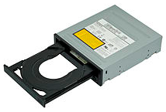
Persistent Storage Devices
Optical Disk Drive (ODD) is a disk drive that uses laser light or electromagnetic waves within or near the visible light spectrum [ˈspektrəm] as part of the process of reading or writing data to or from optical discs.
Compact discs, DVDs, and Blu-ray discs are common types of optical media which can be read and recorded by such drives
DVD writer drive is the most common for desktop PCs and laptops
Notes:
<!-- Brian, Male, British English -->
<speak>
<break time="0.5s"/>
<prosody rate="95%">
Optical Disk Drive (ODD) is a disk drive that uses laser light, or electromagnetic waves within or near the visible light spectrum, as part of the process of reading or writing data to or from optical discs.
<break time="0.3s"/>
Compact discs, DVDs, and Blu-ray discs are common types of optical media which can be read and recorded by such drives.
<break time="0.3s"/>
DVD writer drive is the most common for desktop PCs and laptops.
</prosody>
</speak>
Systems Analysis

Slide 15
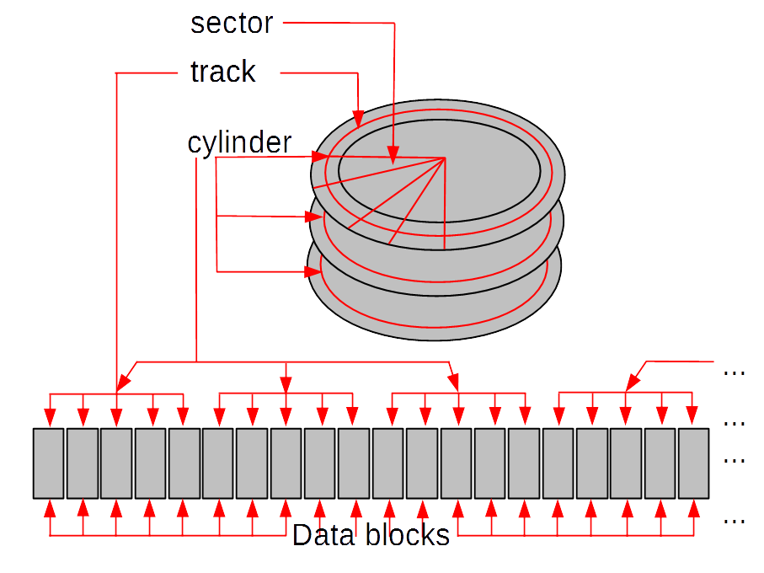
Persistent Storage Devices
Logical model of persistent storage:
Persistent storage is a sequence of fixed size data blocks
A data block is a contiguous sequence of 2 Kbytes, or 4 Kbytes, or 8 Kbytes, or 16 Kbytes, or 32 Kbytes
A data block is identified by a block address
Notes:
<!-- Brian, Male, British English -->
<speak>
<break time="0.5s"/>
<prosody rate="95%">
A logical model of persistent storage is the following.
<break time="0.3s"/>
Persistent storage is visible to the users as a sequence of fixed size data blocks.
<break time="0.3s"/>
A data block is a contiguous sequence of 2 or 4 or 8 or 16 or 32 kilobytes.
<break time="0.3s"/>
A data block is identified by a data block address.
<break time="0.3s"/>
A software maps a sequence of data blocks into sectors, tracks, and cylinders of hard drive.
<break time="0.3s"/>
When a hard disk drive is used, software implements the operations on data blocks as sequences of operations on sectors, tracks, and cylinders. A mapping of sectors, tracks, and cylinders of a hard disk drive in to a sequence of data blocks is visualised on a picture above.
<break time="0.3s"/>
The operations on data blocks include sequential read and write data block operations, and random read an write data block operations.
</prosody>
</speak>
Systems Analysis

Slide 16
References
C. Coronel, S. Morris, A. Basta, M. Zgola, Data Management and Security, Chapter 1, Cengage Compose eBook, 2018, eBook: Data Management and Security, 1st Edition
T. Connoly, C. Begg, Database Systems, A Practical Approach to Design, Implementation, and Management, Chapter 1 Introduction to Databases, Pearson Education Ltd, 2015
Notes:
<!-- Brian, Male, British English -->
<speak>
<break time="0.5s"/>
<prosody rate="95%">
References.
</prosody>
</speak>
Systems Analysis

